Slide 1



ARCHITECTURE OF ELECTRONIC COMPUTING MACHINE & COMPUTING SYSTEMS
Prepared & Presented by: Mirlan Nurbekov, Lecturer
Office hours: Friday 9:00–17:00
AlaToo IT & Business College
Fall 2025

Slide 2
Course Introduction
This course is a journey into the heart of computers, from basic components to full systems.
We'll blend theory with hands-on practice.
We will learn to build and program real-world electronic devices.

Slide 3
Grading & Assessment
Midterm lab test: a comprehensive assessment of materials from week 1 till week 8 (100 points)
Project: a team project where students pick their topic and construct a fully functioning device (100 points)

Slide 4
Ohm's Law (V=IR)
Voltage (V): Think of this as the "pressure" or "push" of electricity. It's the potential difference that makes current flow. Analogy: Water pressure in a hose.
Current (I): The flow of electrical charge. Analogy: The volume of water flowing through the hose.
Resistance (R): The opposition to the flow of current. Analogy: A constriction in the hose that slows down the water.

Slide 5
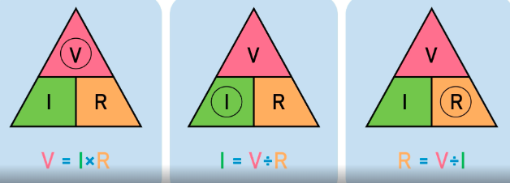
Ohm's Law (V=IR)

Slide 6
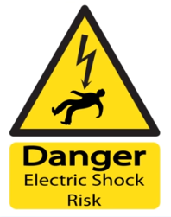
Safety rules in laboratory

Slide 7
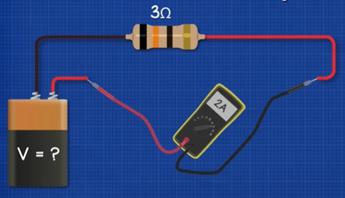

Slide 8
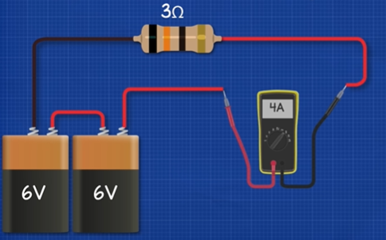

Slide 9
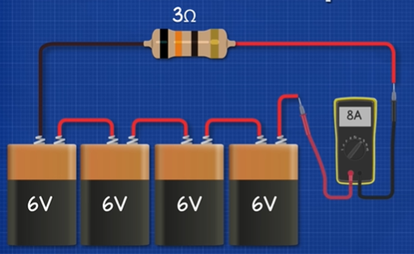

Slide 10
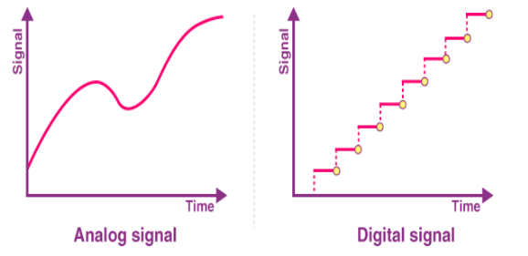
Analog and Digital signals

Slide 11
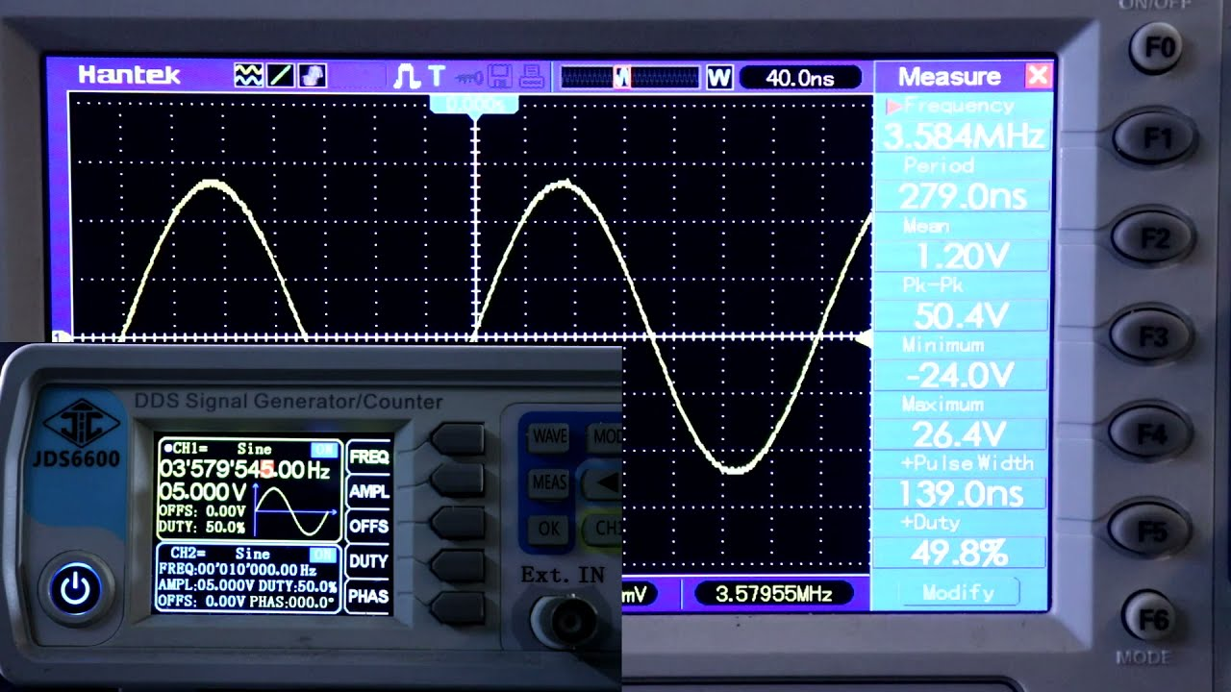

Slide 12
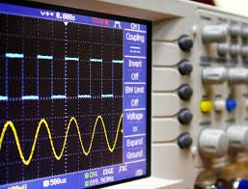

Slide 13
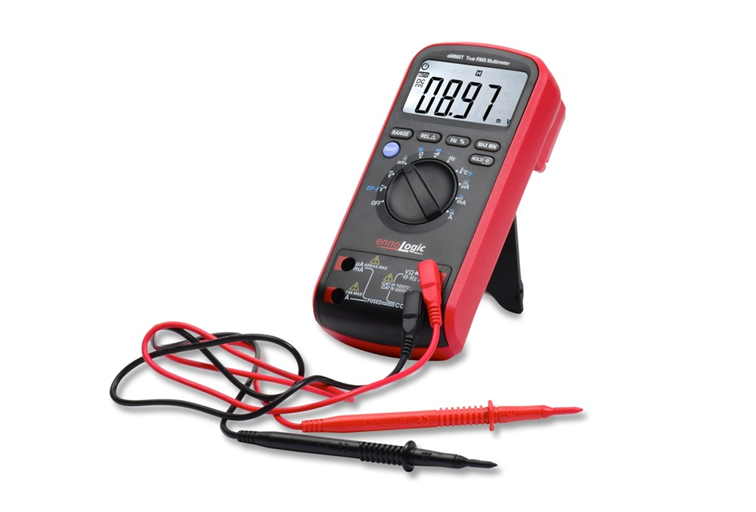
Multimeter

Slide 14
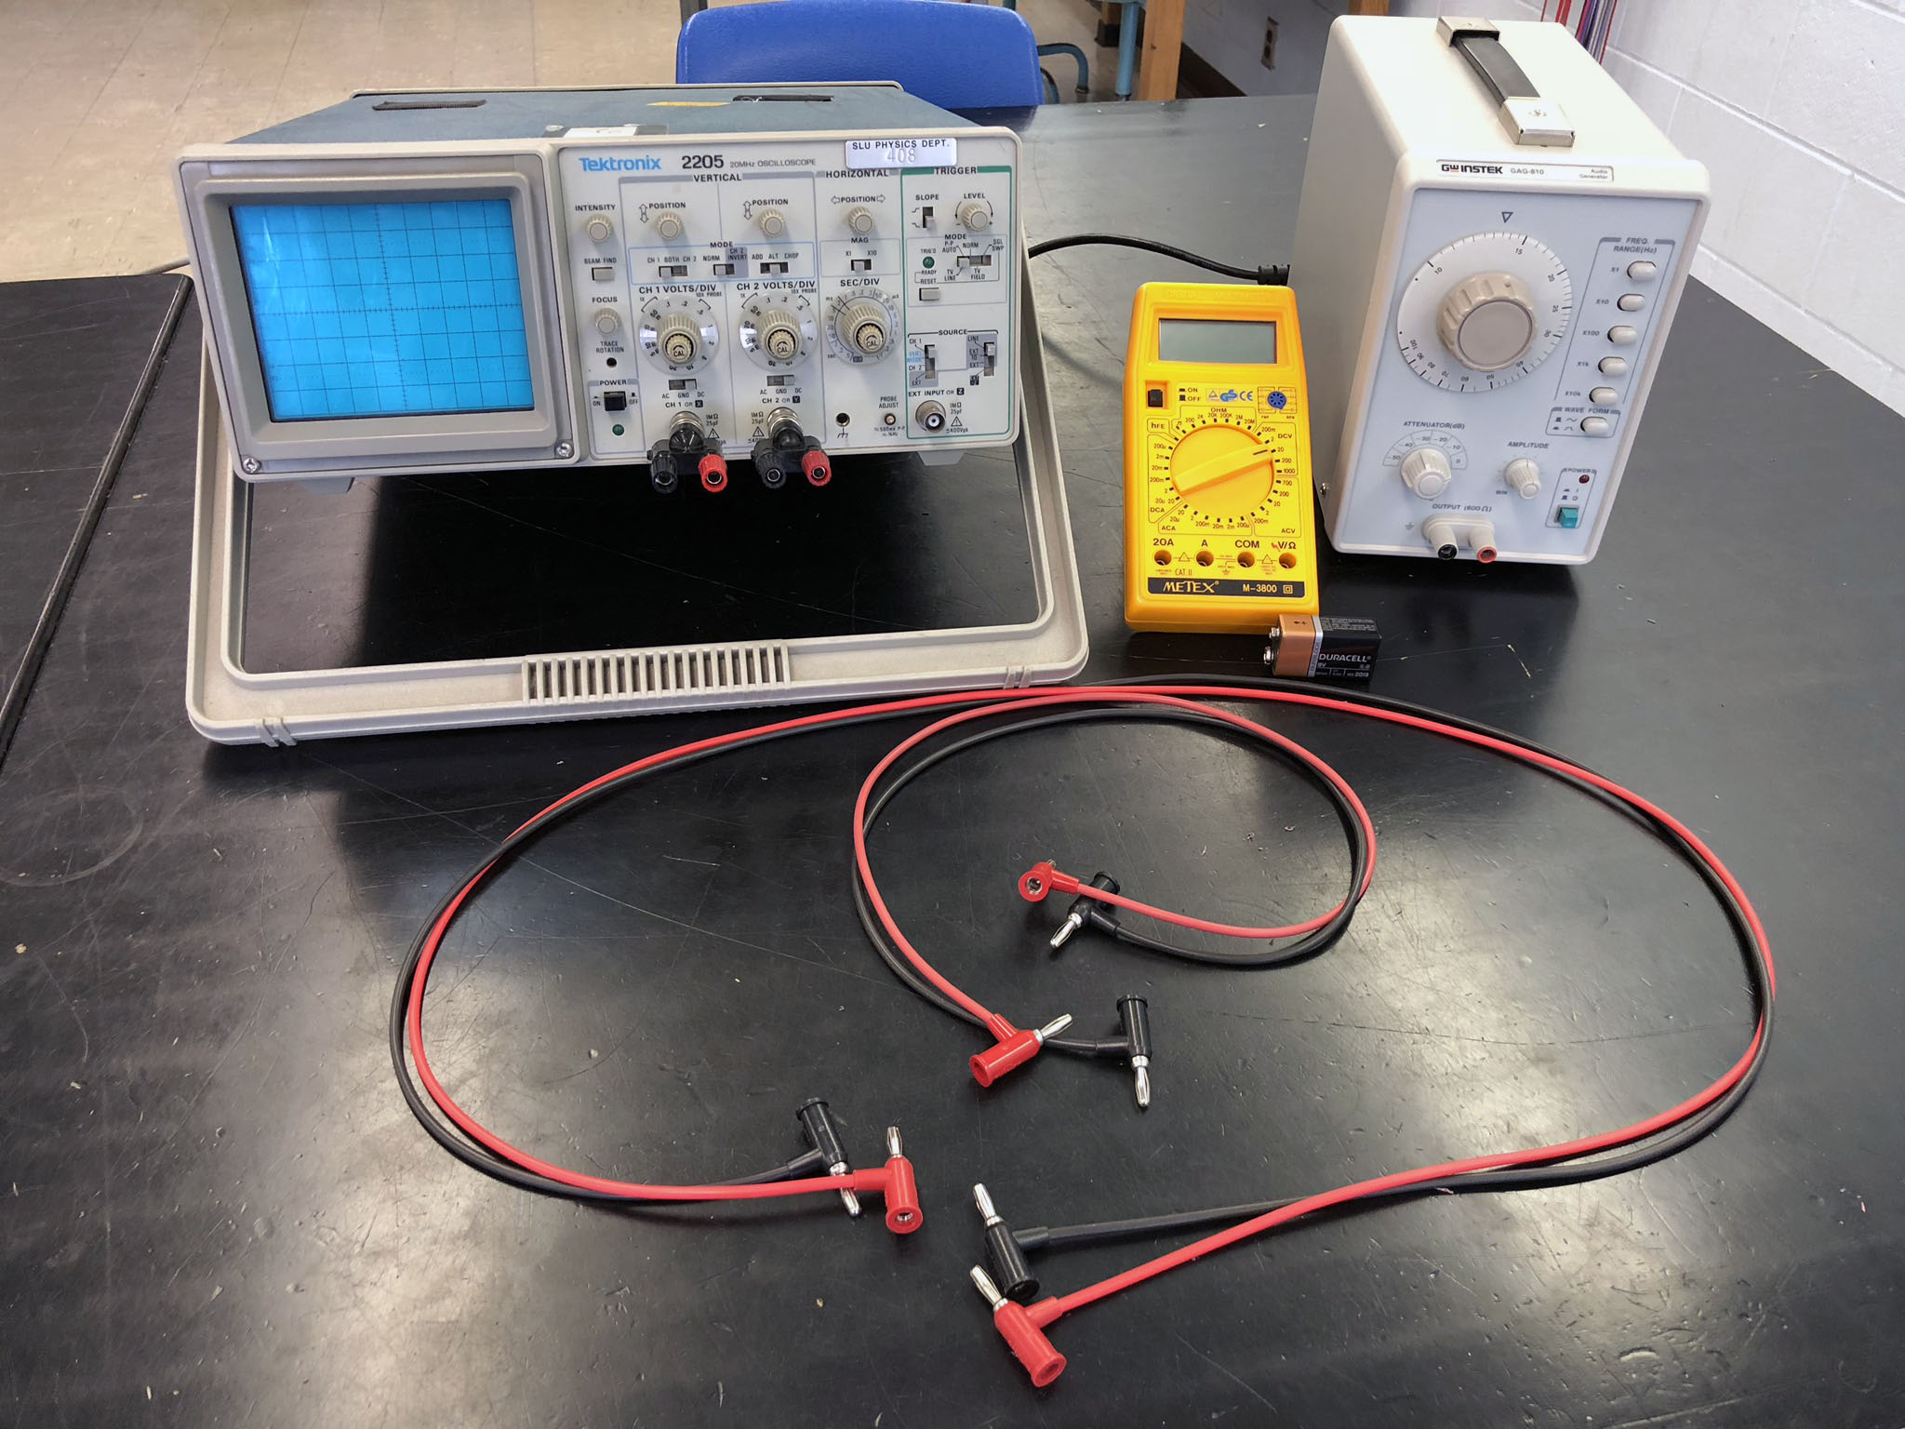

Slide 15
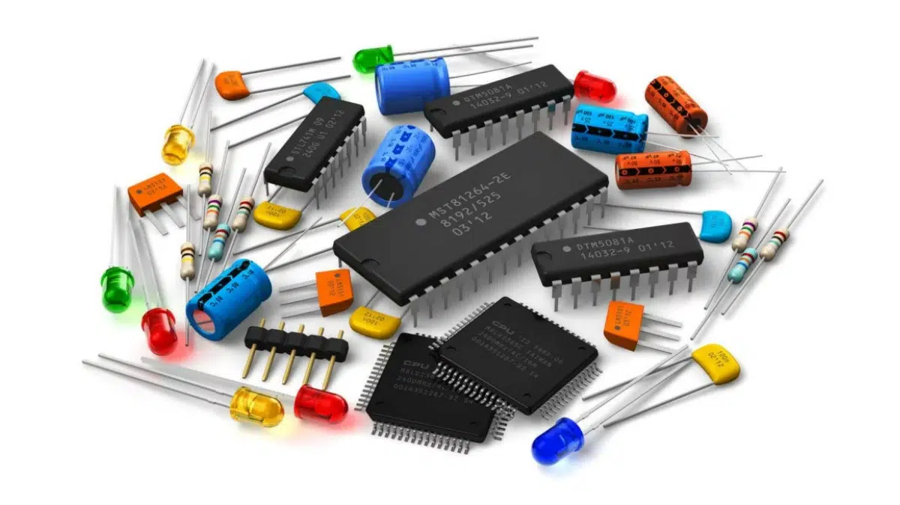
Electronic components

Slide 16
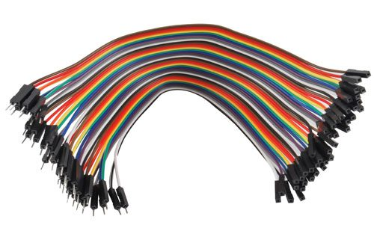
Jumper cables

Slide 17
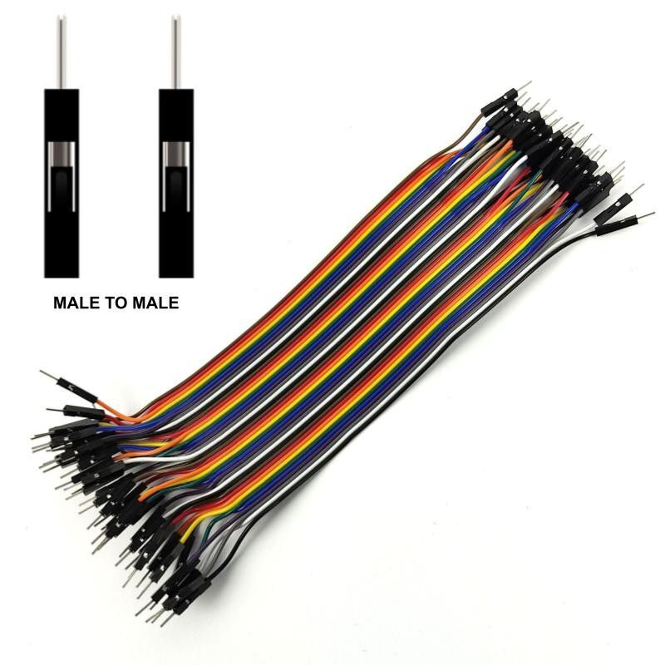
Jumper cables (Male to Male)

Slide 18
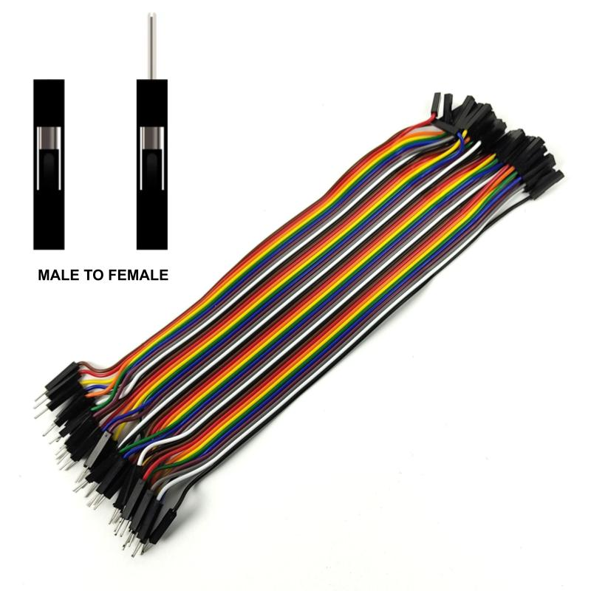
Jumper cables (Male to Female)

Slide 19
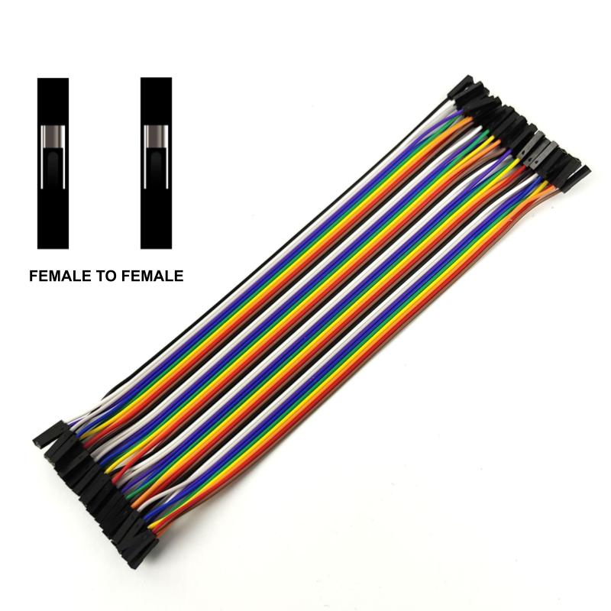
Jumper cables (Female to Female)

Slide 20
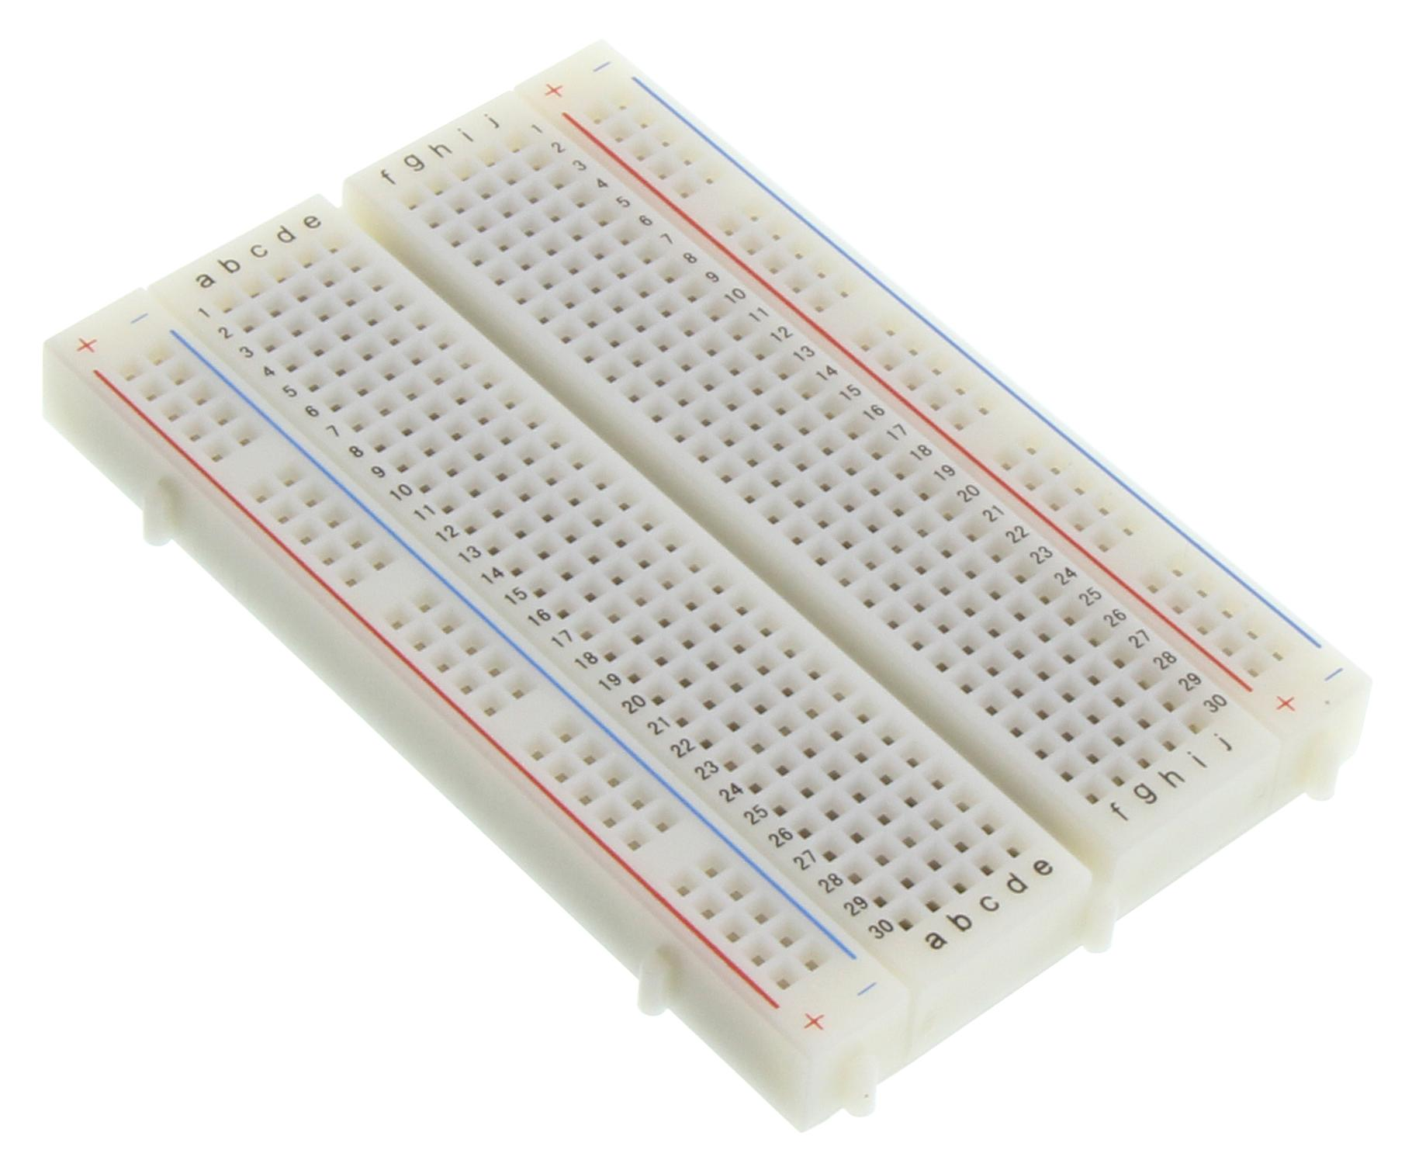
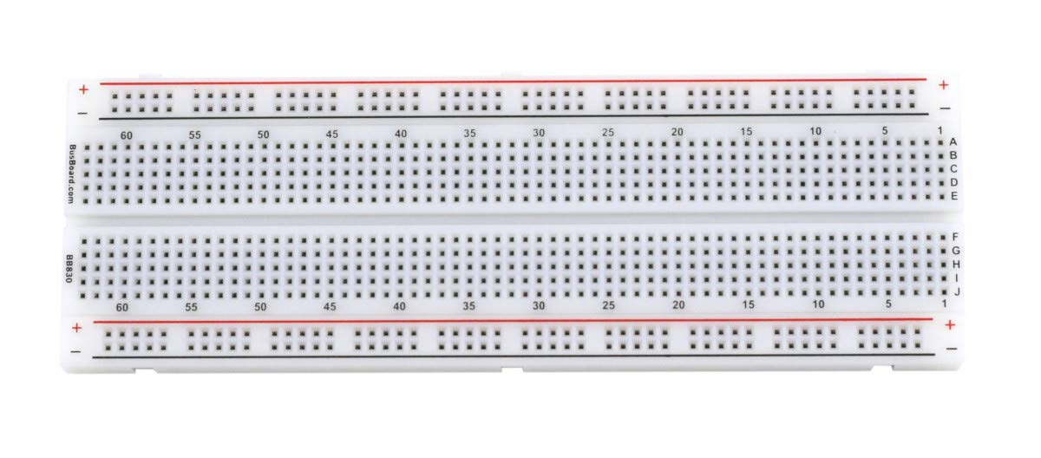
Bread board

Slide 21
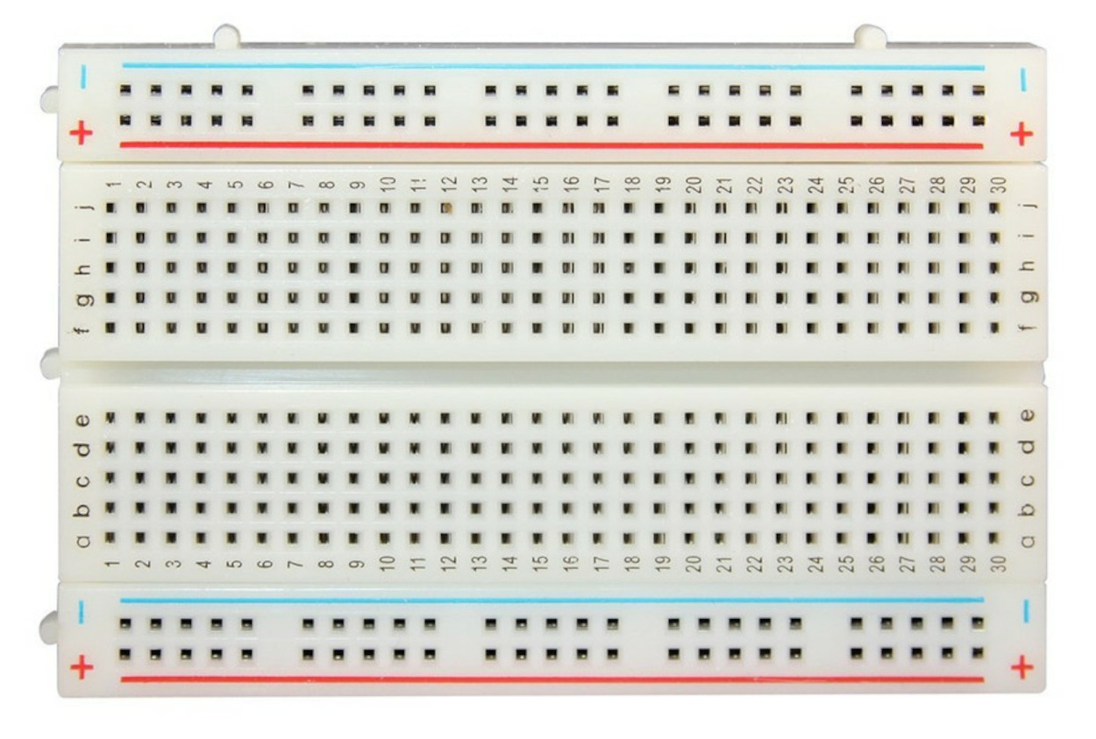
Bread board

Slide 22
Bread board

Slide 23
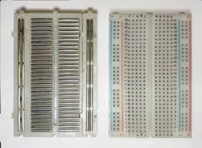
Bread board

Slide 24
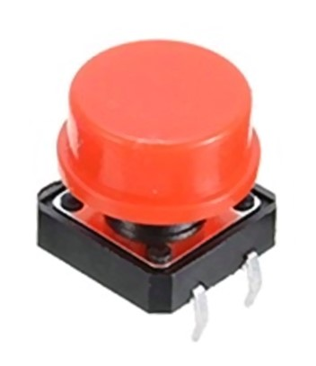
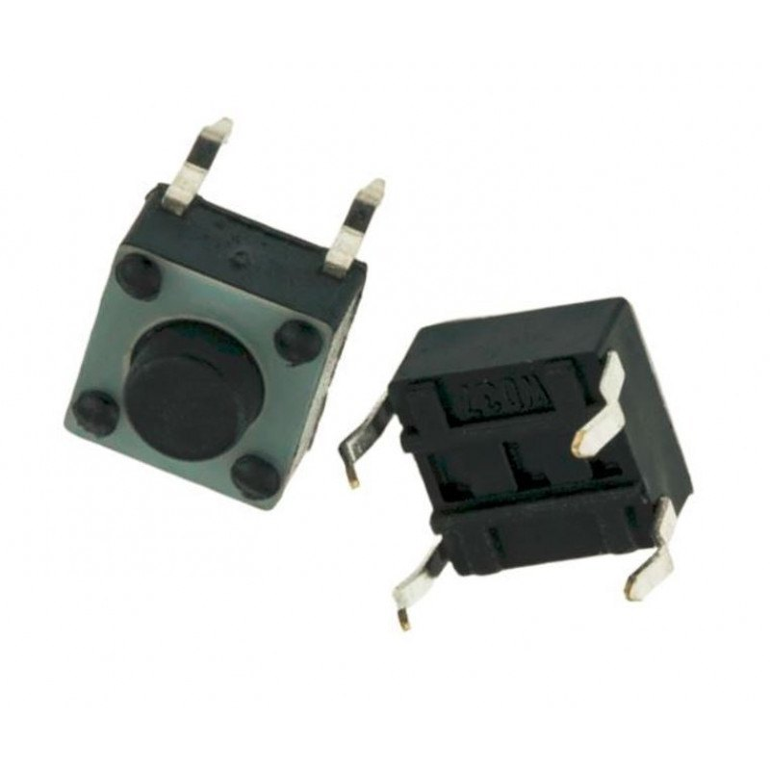
4 pin switch (button)

Slide 25
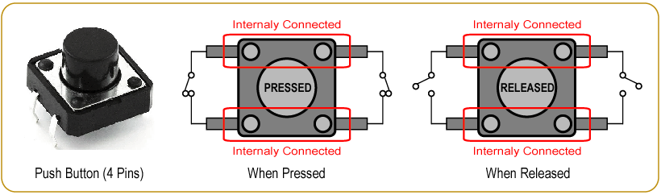
4 pin switch (button)

Slide 26
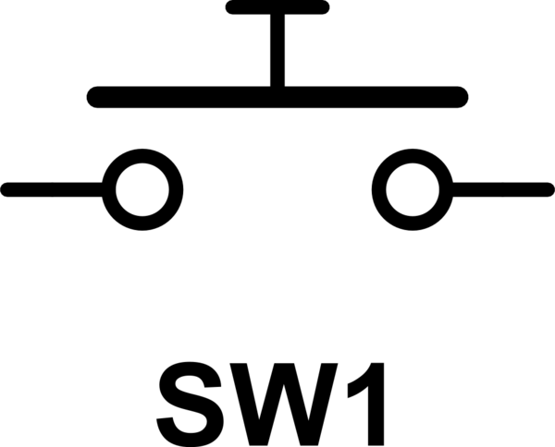
4 pin switch (symbol)

Slide 27
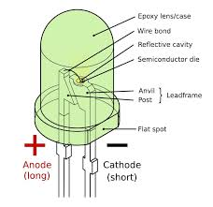
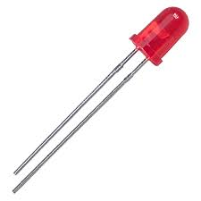
Light Emitting Diode (LED)

Slide 28
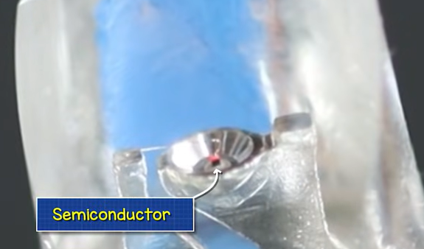
Light Emitting Diode (LED)

Slide 29
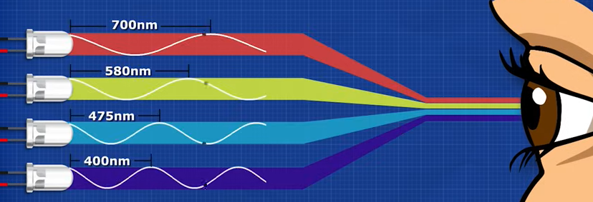
Light Emitting Diode (LED)

Slide 30
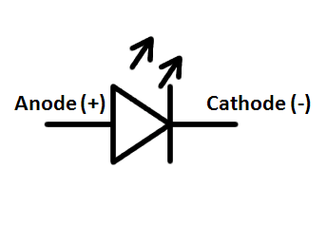
Light Emitting Diode (symbol)

Slide 31
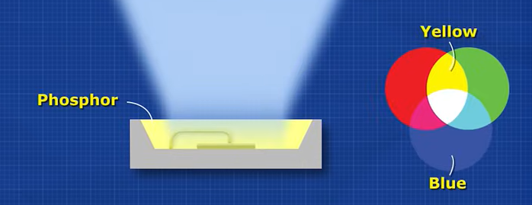
Light Emitting Diode (LED)

Slide 32
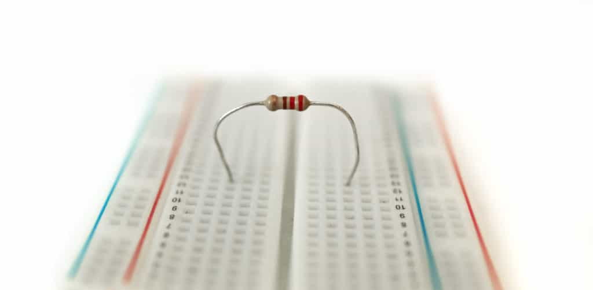
Resistors

Slide 33
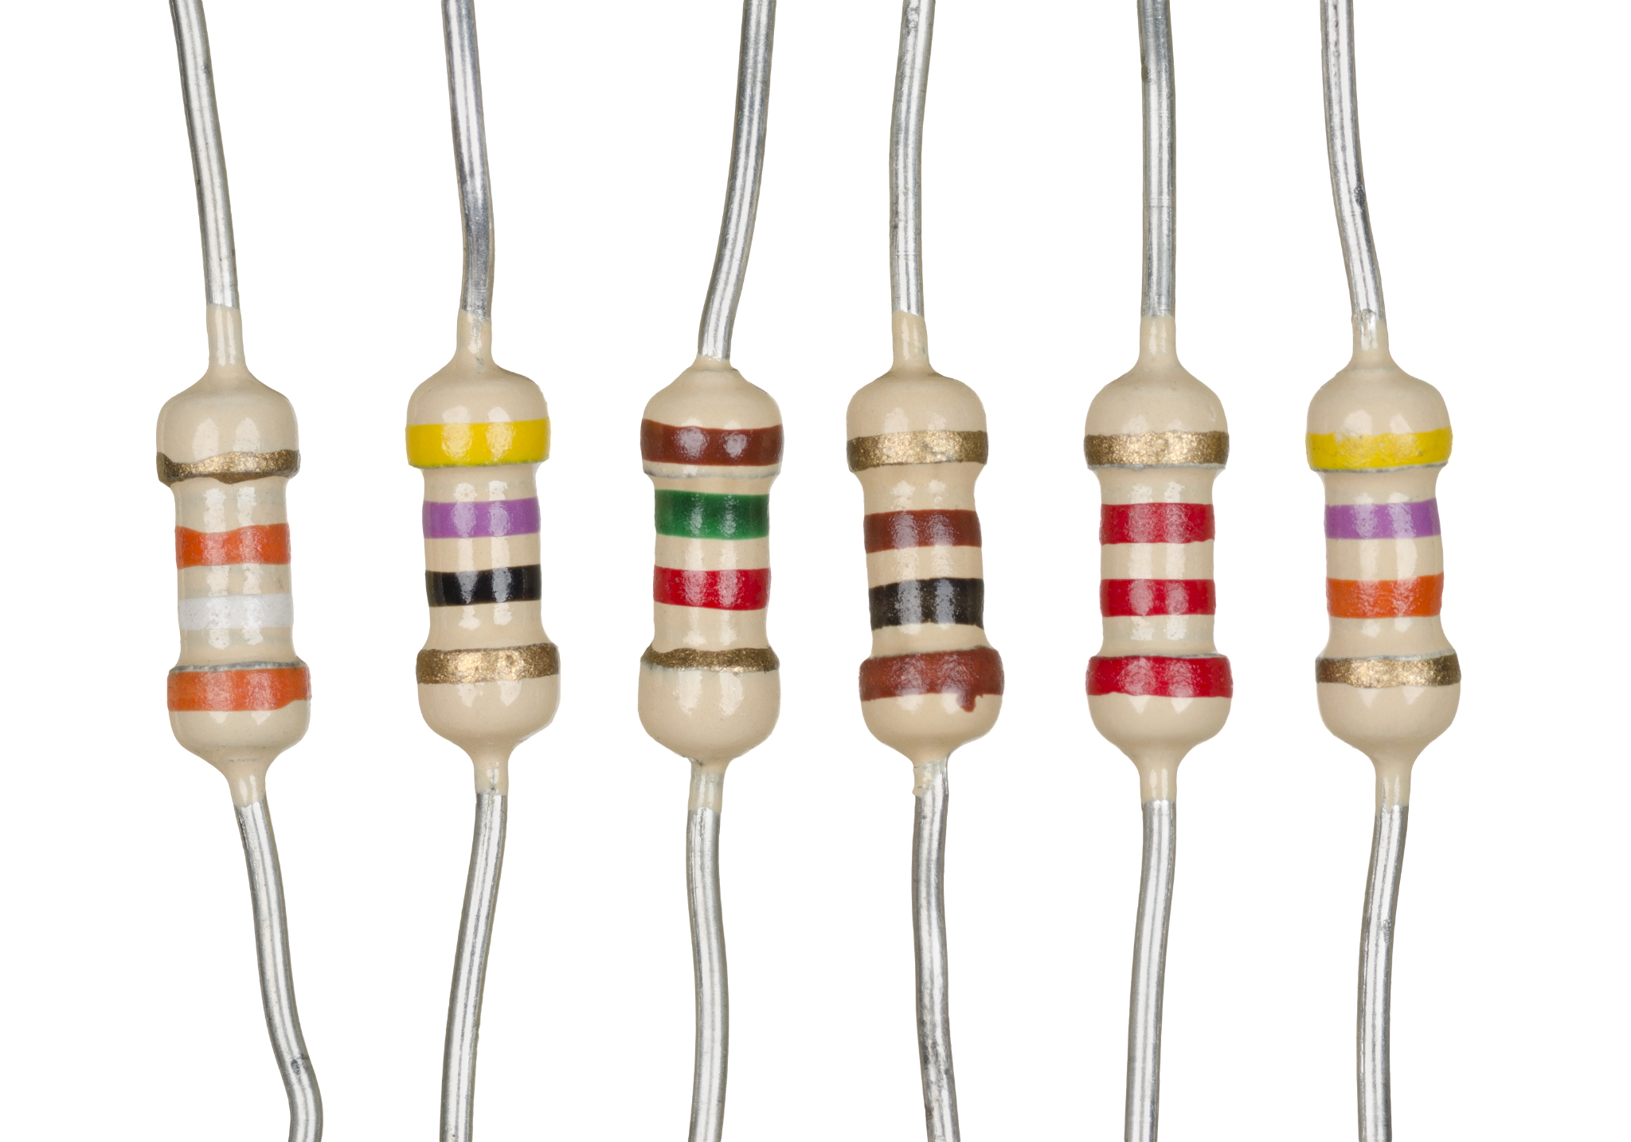
Resistors
Function: Limits current → protects LEDs & components. Example: LED needs ~220Ω–330Ω resistor.

Slide 34
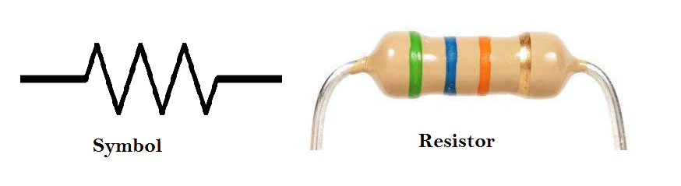
Resistors (symbol)
Function: Limits current → protects LEDs & components. Example: LED needs ~220Ω–330Ω resistor.

Slide 35
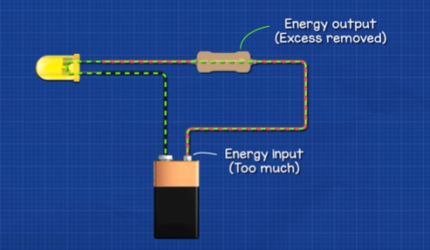
Resistors

Slide 36
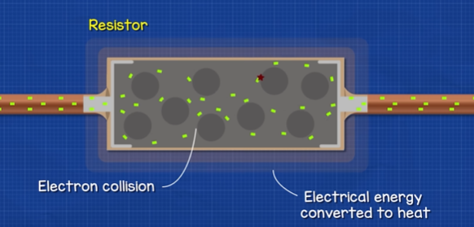
Resistors

Slide 37
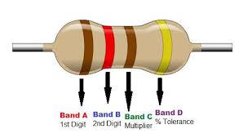
Resistors
Resistor control the flow of electric current in a circuit.
They protect components, divide voltage, and help set the right current levels for electronic devices to work safely and correctly.

Slide 38
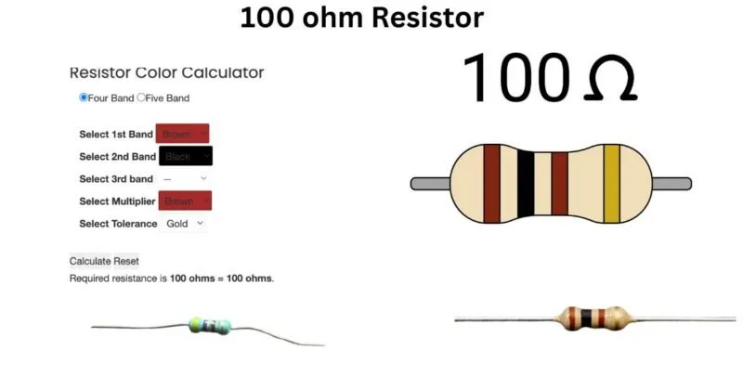
Resistors

Slide 39
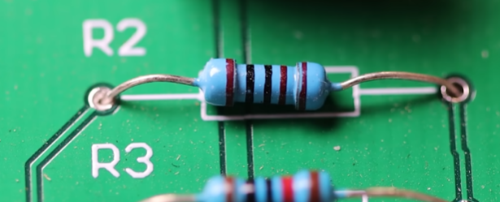
Resistors

Slide 40
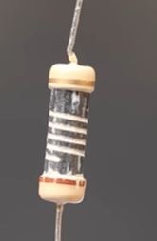
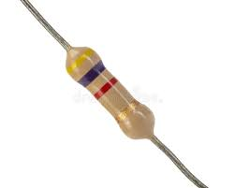
Resistors

Slide 41
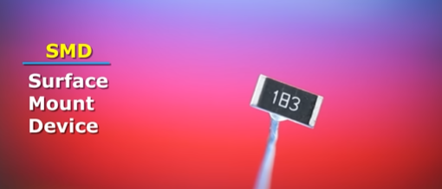
Resistors (SMD)

Slide 42
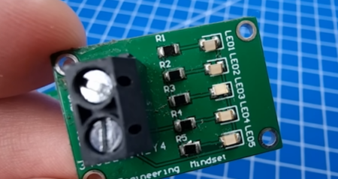
Resistors (SMD)

Slide 43
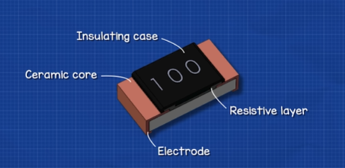
Resistors (SMD)

Slide 44
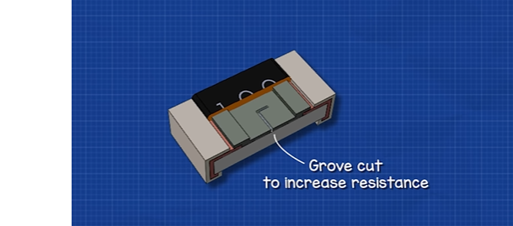
Resistors (SMD)

Slide 45
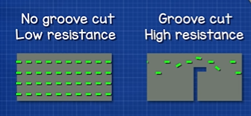
Resistors (SMD)

Slide 46
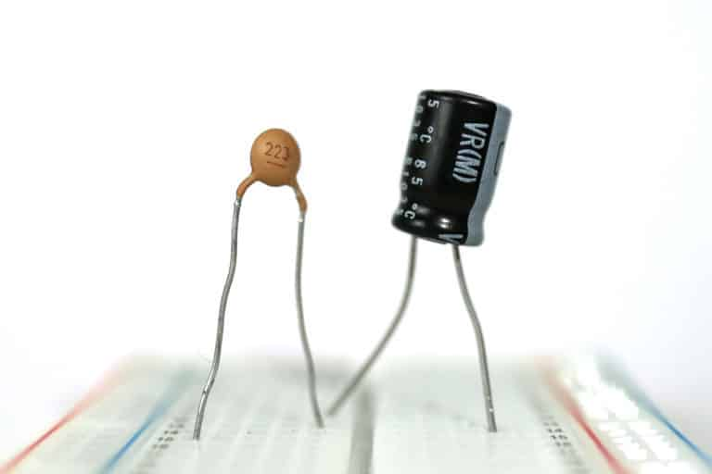
Capacitor

Slide 47
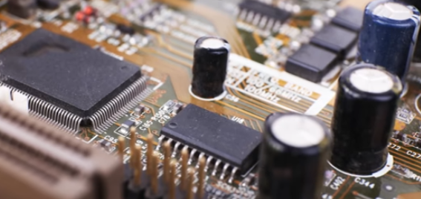
Capacitor

Slide 48
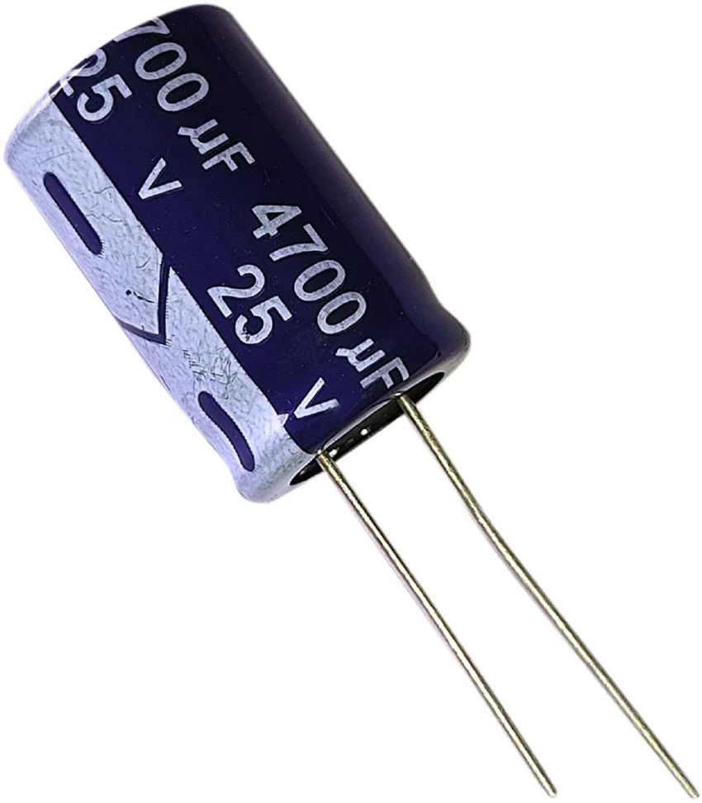
Capacitor
Capacitors store and release electrical energy when needed.
They help smooth voltage, filter signals, and stabilize power in electronic circuits.

Slide 49
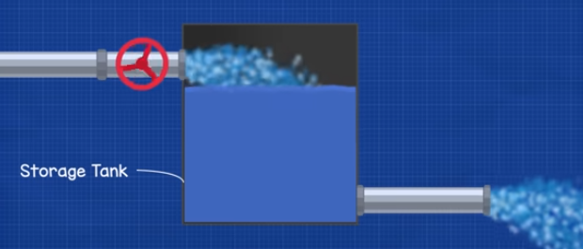
Capacitor

Slide 50
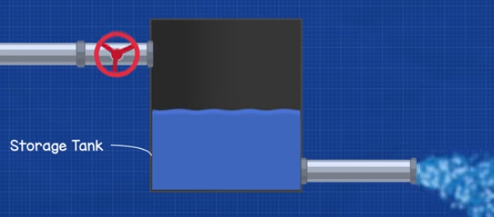
Capacitor

Slide 51
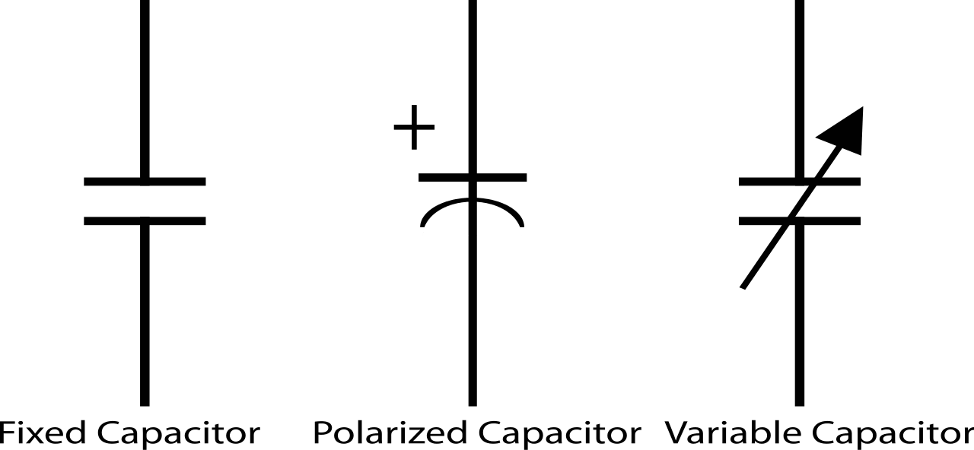
Capacitor (symbol)

Slide 52

Capacitor

Slide 53

Capacitor

Slide 54

Capacitor

Slide 55

Capacitor is getting charge

Slide 56

Capacitor

Slide 57

Capacitor

Slide 58
Capacitor

Slide 59

Transistor

Slide 60

Transistor
Transistor control the flow of current, allowing devices to process signals, store data, and perform logic operations — making them the building blocks of all modern electronics.

Slide 61

Transistor (symbols)

Slide 62

Transistor (part number)

Slide 63

Transistor (data sheet)

Slide 64

Transistor (typical configuration)

Slide 65


Basic circuit

